Slide 1
Connecting to MySQL

Slide 2
The Process
The basic steps of performing a query, whether using the mysql command-line tool or PHP, are the same:
Connect to the database.
Select the database to use.
Build a SELECT statement.
Perform the query.
Display the results.

Slide 3
Resources
When connecting to a MySQL database, you will use two new resources.
The link identifier resource
holds all of the information necessary to connect to the database for an active connection.
The results resource
contains all information required to retrieve results from an active database query’s result set.

Slide 4
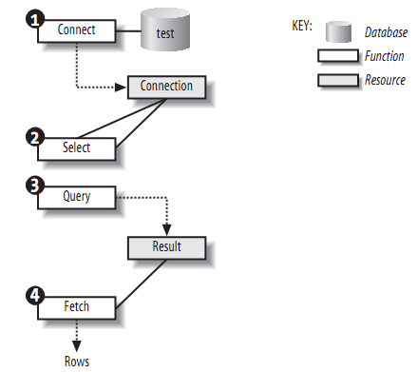
The interaction between functions and resources

Slide 5
Including Database Login Details
<?php
$db_host='hostname of database server';
$db_database='database name';
$db_username='username';
$db_password='password';
?>
Including the file that you set up to store your connection information allows you to use the variables instead of hardcoded values when you call the mysql_connect function.

Slide 6
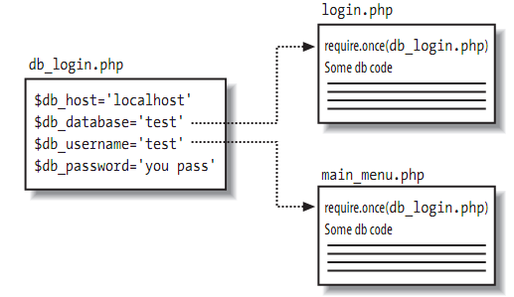
Reusing the login details in multiple files

Slide 7
Querying database using procedural approach

Slide 8
Connecting to the Database
mysqli_connect($db_host,$db_username,$db_password,$db_database)
This function takes some parameters:
The database host
The database username
The database password
The database name (optional)
If the connection is successful, a link to a database is returned.
FALSE is returned if a connection can’t be made.

Slide 9
Check Error Connection Message
mysqli_connect_errno()
Returns an error code value
Zero if no error occurred
mysqli_connect_error()
Return an error description from the last connection error, if any.

Slide 10
Connecting to the Database (2)
<?php
// Include our login information
require_once('db_login.php');
// Connect
$connection = mysqli_connect($db_host, $db_username, $db_password,$db_database);
if (mysqli_connect_errno()){
die ("Could not connect to the database: <br />". mysqli_connect_error());
}?>

Slide 11
Selecting the Database
mysqli_select_db($connection,$db_database)
This function is used to change the default database for the connection
It takes two parameters:
database connection
the database name
It returns TRUE on success or FALSE on failure.

Slide 12
Selecting the Database (2)
<?php
// Select the database
$db_select=mysqli_select_db($connection,$db_database);
if (!$db_select)
{
die ("Could not select the database: <br />". mysqli_error($connection));
}
?>

Slide 13
Displaying Error Message
mysqli_error($connection)
It displays error messages if there’s a problem, such as an incorrect database name.
die()
This function displays the error and stops the program.

Slide 14
Building the SQL SELECT Query
Assing the query to the string variable
The query you send to MySQL does not need a semicolon at the end of it, unlike a query you type into the MySQL monitor.
// Assign the query
$query = " SELECT * FROM books ";

Slide 15
Executing the Query
mysqli_query($connection,$query)
This function is used to execute the query.
It takes two parameters
database connection
the query
It returns the result
The result can be stored in a variable, ex: $result.
If there are some errors in the query string or the database connection the $result will be FALSE.

Slide 16
Executing the Query
// Execute the query
$result = mysqli_query($connection,$query);
if (!$result){
die ("Could not query the database: <br />". mysqli_error($connection));
}

Slide 17
Fetching and Displaying
mysqli_fetch_row($result)
This function is used to get the rows from the result set.
It takes the result you stored in $result from the query as a parameter.
It returns one row at a time from the query until there are no more rows, and then it returns FALSE.
mysqli_num_rows($result)
It returns the total rows of result query.

Slide 18
Fetching and Displaying
// Fetch and display the results
while ($row = mysqli_fetch_row($result)){
echo 'ISBN: '.$row[0] . '<br />';
echo 'Author: '.$row[1] . '<br /> ';
echo 'Title: '.$row[2] . '<br /> ';
echo 'Price: '.$row[3] . '<br /><br />';
}
echo 'Total Rows = '.mysqli_num_rows($result);

Slide 19
Fetching and Displaying
mysql_fetch_array($result,resulttype)
This function fetches a result row as an associative array, a numeric array, or both.
It takes 2 parameters
Result query
Resulttype (the way to bind the results as an optional second parameter).
Resulttype can be one of this:
MYSQLI_ASSOC (default value) : fetch row as associative array.
MYSQLI_NUM : fetch row as numeric array.

Slide 20
Fetching and Displaying
// Fetch and display the results
while ($row = mysqli_fetch_array($result,MYSQLI_ASSOC)){
echo 'ISBN: '.$row['isbn'] . '<br />';
echo 'Author: '.$row['author'] . '<br /> ';
echo 'Title: '.$row['title'] . '<br /> ';
echo 'Price: '.$row['price'] . '<br /><br />';
}

Slide 21
Fetching and Displaying
mysqli_fetch_object($result)
It returns the current row of a result set, as an object.
// Fetch and display the results
while ($row = mysqli_fetch_object($result)){
echo 'ISBN: '.$row->isbn.'<br />';
echo 'Author: '.$row->author.'<br /> ';
echo 'Title: '.$row->title.'<br /> ';
echo 'Price: '.$row->price'.'<br /><br />';
}

Slide 22
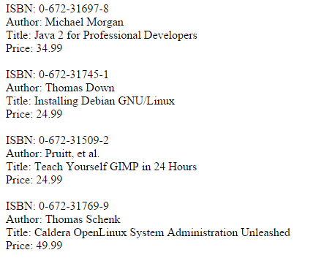
Fetching and Displaying

Slide 23
Closing the Connection
Close a connection to a database when you’re done using it.
Closing a database with mysql_close will tell PHP and MySQL that you no longer will be using the connection, and will free any resources and memory allocated to it.
mysqli_close($connection)

Slide 24
Querying database using
object oriented approach

Slide 25
Connecting to the Database
Creates an object of mysqli class and creates a connection to host $db_host with username $db_username, and password $db_password.
$db = new mysqli($db_host, $db_username, $db_password, $db_database);
Checking error connection
if ($db->connect_errno){
die ("Could not connect to the database: <br />". $db->connect_error);
}
$db-> connect_errno returns an error number on error, or zero on success.
$db->connect_error print error connection messages.

Slide 26
Selecting the Database
$db_select = $db->select_db($db_database);
if (!$db_select)
{
die ("Could not select the database: <br />". $db->error);
}
$db->error print the mysql error messages.

Slide 27
Executing the Query
// Execute the query
$result = $db->query( $query );
if (!$result){
die ("Could not query the database: <br />". $db->error);
}

Slide 28
Fetching and Displaying
// Fetch and display the results
while ($row = $result->fetch_object()){
echo 'ISBN: '.$row->isbn.'<br />';
echo 'Author: '.$row->author.'<br /> ';
echo 'Title: '.$row->title.'<br /> ';
echo 'Price: '.$row->price.'<br /><br />';
}
echo 'Total Rows = '.$result->num_rows;

Slide 29
Closing the Connection
You can free up your resultset by calling either
$result->free();
You can close the connection use
$db->close();

Slide 30
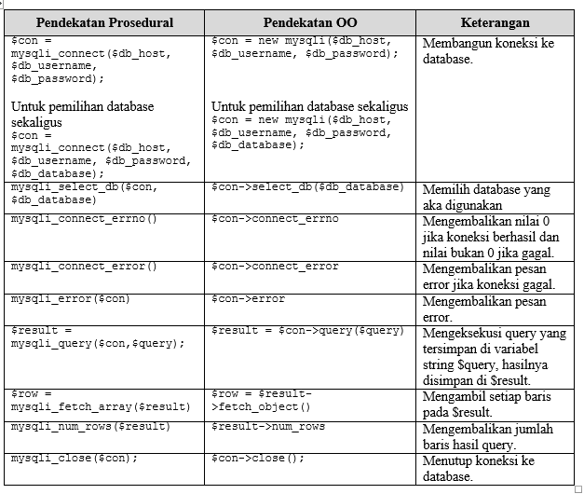

Slide 31
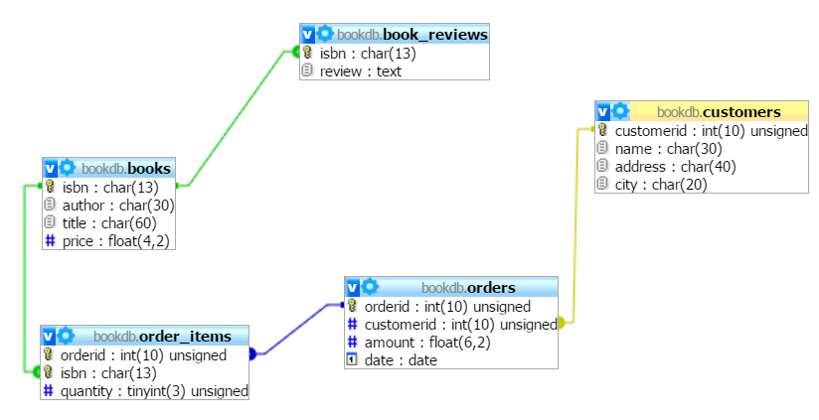
Example: Struktur Database bookdb

